Slide 1
I211 – Information Infrastructure II
Lecture 17

Slide 2
Storing Data
Data comes from many sources and in many formats
Medical records
Credit card logs
Molecular structures
Inventory logs
Data set size can also vary greatly!
< 50 KB (30 student records)
GBs / day (4 billion new records / day: Hemisphere phone call metadata, as recorded by AT&T for the DEA)
150 PB Size of Hotmail accounts’ data in 2013 1 PB = 1,000,000 GB

Slide 3
Storing Data
Data management depends on size and need
Tiny data sets could be handled as text files
How is sharing managed?
Small data sets could be handled in Excel
Class grades
Personal finances

Slide 4
Storing Data
Medium - Large datasets and circumstances where we need fast access to specific data demand a DBMS:
DataBase Management System
Even small data sets can be much more usable in a DBMS

Slide 5
Ways to Store Data
Flat File
Essentially just an on-disk list of records
Data must be searched sequentially
XML Document
Generally used as an intermediary storage format
Relational Database (What we’ll be using)
Modern approach
Access, SQL Server, MySQL, Oracle

Slide 6
What Does a Database Do?
Efficiently stores different types of data
Maintains integrity of data
Efficiently allows data extraction based on queries
It doesn’t:
Inherently perform calculations
Present data in a nice interface
We do these with it!

Slide 7
Data Types
Data of different types are stored differently:
Names <first> <middle> <last>
Dates <day> / <month> / <year>
Ages Number between 0-120
Prices <currency symbol> <units> . <subunits>
Media files JPG, MP3, AVI File formats

Slide 8
Operations on Data
We may want to do different things to different types of data:
Name – Find all people whose name starts with ‘S’
Date – Find the number of days since 01/12/2003
Age – Find all people who have age > 65
Price – Order all items from lowest to highest

Slide 9
Data Constraints
Depending on type, there are also things that don’t make sense (constraints):
Age and Price can’t be negative
Name can’t be the empty string (NULL)
Date can’t be before 1900 (or 2000, etc)
This one is application-specific!
Art history DB may require very old dates

Slide 10
Data Integrity
The DBMS should not allow you to mess up the data!
If you delete a person from the system, should all records related to them be deleted?
You should not be able to set a due date before today’s date.
You should not be able to enter duplicate records (usually).

Slide 11
Data Queries
Most importantly, a DBMS should allow us to efficiently query data!
Find all patients admitted on last Thursday
Find all students enrolled in I211 who are not enrolled in C241
Find all stocks whose volume was > 200,000 last month

Slide 12
Data Queries
So why use a DB?
We can already do these queries with an XML file of data and Python
But if we have 2,000,000 records and need the result in < 2 seconds…
Time to move to a real DBMS!

Slide 13
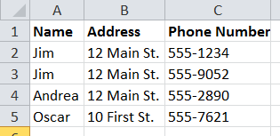
Relational DBs
Data can be broken into units that are fundamentally related
Multiple people could live at the same address, and each person might have multiple phone numbers

Slide 14
Relational DBs
We start out with tables containing information. Tables are also called entities.
A table has one or more columns, called fields.
A table has zero or more rows, called records.

Slide 15
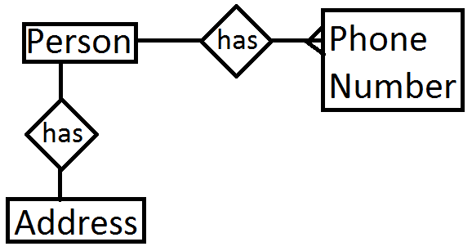
Relational DBs
Relationships are formed when data in a field in one table matches data in a field in another table.
Thus, a map of the relationships in a database is called an ER Diagram (Entity-Relationship)
One ‘table’ in Excel
Three tables in a relational DB

Slide 16
Relational DBs
Choosing how many tables should be used and what data they should contain is a large part of setting up a good DB
It’s a complicated topic with an entire field of study devoted to it, and well-established rules for design
Try to think about how the data will be used. If there can be more than one Y that goes with X, X and Y probably need their own tables.
Think of tables as whole objects or concepts if this helps.

Slide 17
Relational DBs
Tables need fields that connect them to other tables.
For example, in a hospital, a Physician might deliver a Baby for a Mother.
Since there could be 2 doctors with the same name, or 2 mothers with the same name, we need to use unique ID numbers instead!
This is why we all have lots of ID numbers: SSN, University ID #, DL #, etc.

Slide 18
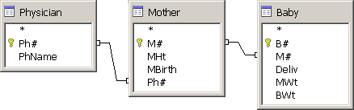
Relational DBs
In a hospital, a Physician might deliver a Baby for a Mother.
The Baby table has a field for Mother#, which can be used to find a mother in the Mother table!

Slide 19
MySQL
A popular DB for web applications, since it’s free
SQL stands for Structured Query Language
Standard SQL works with almost any modern DBMS
T-SQL – An extension to SQL used by Microsoft for its products (SQL Server). T-SQL commands will not work with MySQL!

Slide 20
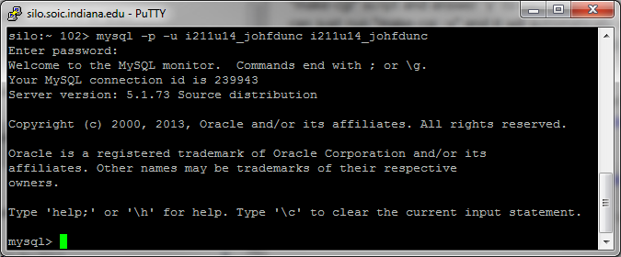
Logging Into MySQL
Use PuTTY to connect to: db.soic.indiana.edu
Login as your IU account
At the prompt, type:
mysql –p –u i211u14_username i211u14_username
The first one is your DB username, the second is the DB name (Both are currently the same. Replace ‘username’ with yours)
Your Initial Password: my+sql=i211u14_username

Slide 21
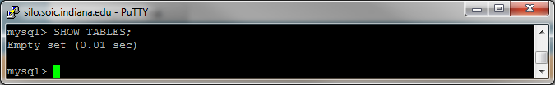
MySQL – View Current Tables
To view the current contents of the DB, type this into the prompt, then hit Enter: SHOW TABLES;
In theory, your DB will be empty.

Slide 22
MySQL – Creating a Table
Creating a Table:
Provide a table name (Must be unique!)
Decide on the fields (Must be unique inside table!)
Decide on a type for each field
Convert this into an SQL statement and execute it

Slide 23
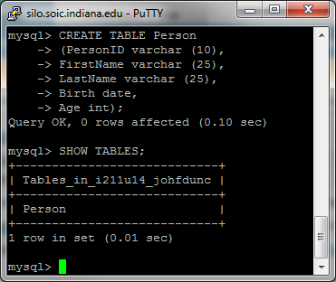
MySQL – Creating a Table
CREATE TABLE table_name (field1 type1, field2 type2, etc. );
Try this
http://www.tutorialspoint.com/mysql/mysql-data-types.htm
http://dev.mysql.com/doc/refman/5.0/en/creating-tables.html

Slide 24
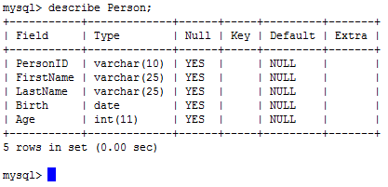
MySQL – Table Details
See table details: describe Tablename;

Slide 25
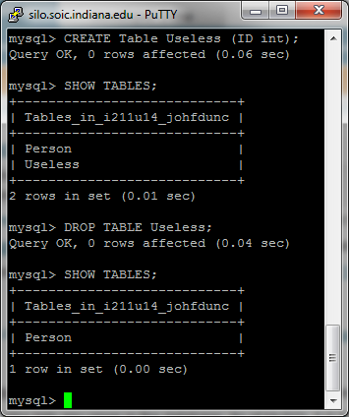
MySQL – Deleting Tables
Getting rid of tables:
DROP is permanent!
Be careful!
(You can scroll through previous commands with the UP and DOWN arrows)

Slide 26
MySQL – Field Constraints
It doesn’t make sense to have two people with the same ID number SQL: UNIQUE
It doesn’t make sense to have a person without a name SQL: NOT NULL
If most of the people in our table are 18, let’s make that the default age SQL: DEFAULT 18

Slide 27
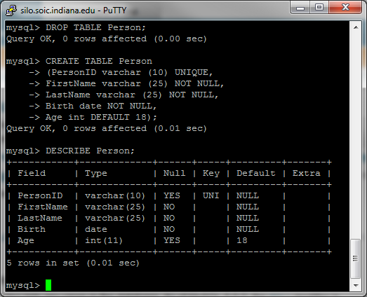
MySQL - Remaking Our Table
Since this value is UNIQUE, we can use it as a Key for this table!
This is how we will connect it to another table’s data.
MySQL automatically assigns the first Unique value to be a Key for that table.

Slide 28
MySQL – Inserting Data
General format:
INSERT INTO table_name VALUES (val1, val2, etc.);
You generally provide values for each field in the table
Make sure you can insert a row with those values – constraints!

Slide 29
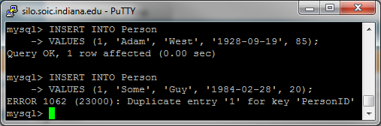
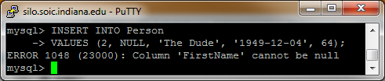
MySQL
UNIQUE prevents us from inserting two people with the same PersonID:
Similarly, we can’t insert a NULL FirstName:

Slide 30
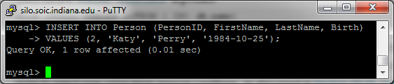
MySQL
If column names are not specified, the number of values to be inserted must match the number of columns, even with defaults!
Better practice is to specify the column names, allowing us to skip things with defaults:

Slide 31
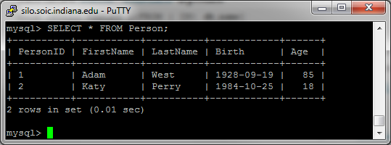
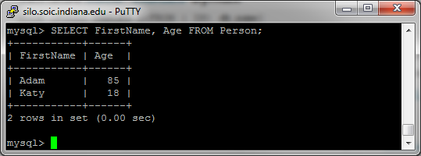
MySQL – Selecting Data
To see what we’ve inserted:
* is a wildcard that means ‘everything’

Slide 32
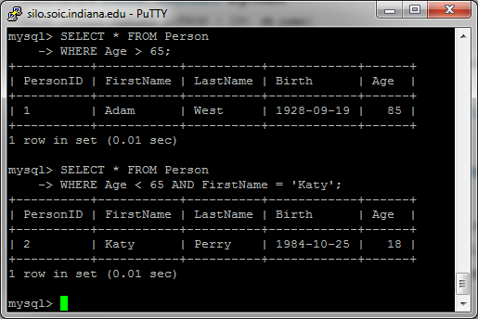
MySQL – Selecting Data
We can also put constraints on the data using WHERE:

Slide 33
MySQL - Exiting
To stop using MySQL, type ‘exit’
To log back in: mysql –p –u i211u14_username i211u14_username
Your Initial Password: my+sql=i211u14_username

Slide 34
Basic SQL (Group Work)
Continue to expand Person by adding 8 more celebrities. Look up their real ages and dates of birth!
Show us 3 SELECT queries on your Person data that produce different results.
Create another table, House, with these fields:
HouseID (varchar 10, no duplicates), City (varchar 25, can’t be empty), Value (int, default 100,000), Owner (varchar 10)
Everyone in your group should have their own copy of the data!

Slide 35
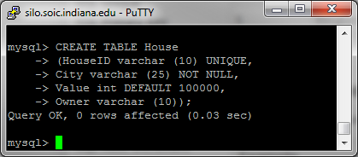
Basic SQL (Partial Solution)

Slide 36
SQL – More on Select Statements
General format:
SELECT columns FROM table_name WHERE column_name operator value;
Operators:
=, <> (not equal to), >, >=, <, <=
BETWEEN (an inclusive range)
LIKE (a pattern)

Slide 37
SQL – Select Statements
Select all people whose age is > 35 and <45
SELECT FirstName, LastName FROM Person WHERE Age > 35 and Age < 45;
Or:
SELECT FirstName, LastName FROM Person WHERE Age BETWEEN 36 and 44;

Slide 38
SQL – Select Statements
% is a wildcard matching anything, so we can get all rows with a last name:
Starting with ‘Pe’ (not case sensitive)
SELECT * FROM Person WHERE LastName LIKE ‘Pe%’;
Ending with ‘t’
SELECT * FROM Person WHERE LastName LIKE ‘%t’;
Containing ‘es’
SELECT * FROM Person WHERE LastName LIKE ‘%es%’;

Slide 39
SQL – Delete Statements
Deleting All Rows:
DELETE FROM House;
Permanent! Be careful!
Leaves the table structure there, so you can start fresh

Slide 40
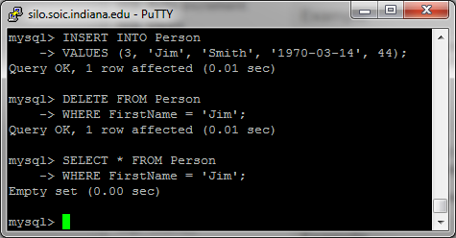
SQL – Delete Statements
Don’t forget the WHERE clause!!

Slide 41
SQL – Update Statements
This is how we change values in a table without deleting a row and re-adding it
General format:
UPDATE table_name SET column_name = new_value
WHERE column_name = old_value;
This can update multiple rows, so be careful!

Slide 42
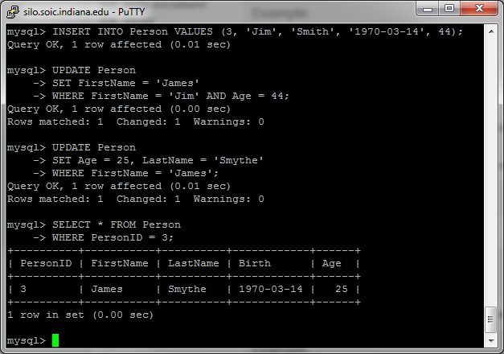
SQL – Update Statements
We can update multiple fields at once:

Slide 43
SQL – Ordering Results
You can change the order in which rows are returned
Why do we want to do this?
Get lowest or highest value
Get the top X results
Display data in alphabetical order, or numeric order

Slide 44
SQL – Ordering Results
You can ORDER BY a specific column in the table:
SELECT * FROM Person ORDER BY Age;
SELECT * FROM Person ORDER BY LastName;
SELECT * FROM Person ORDER BY Birth DESC;
DESC reverses the order (descending order)

Slide 45
SQL – Limiting Results
If you really just want the top X results, there’s no need to make the DB work harder
Speed up your query by using LIMIT:
SELECT * FROM Person
ORDER BY Age LIMIT 10;

Slide 46
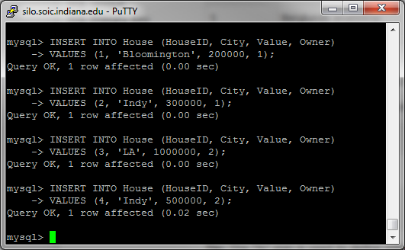
SQL – Joining Tables
To see how relationships work, we need 2 tables that have a relationship.
Insert this data into your House table:

Slide 47
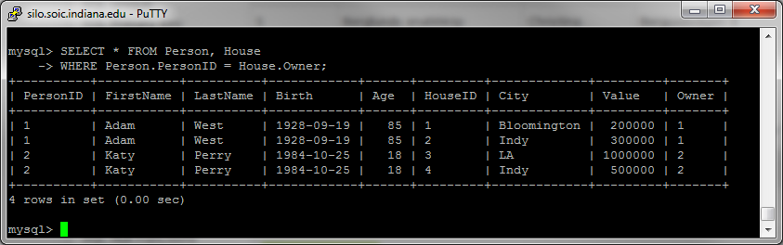
SQL – Joining Tables
We can join two tables (produce a temporary table that has information from both) by matching a field in one table to a field in the other:
Here, we match Person’s PersonID to House’s Owner:

Slide 48
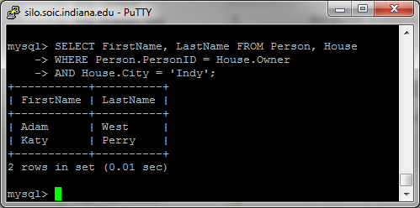
SQL – Joining Tables
Here, we get the FirstName and LastName of anyone who has a house in Indy:

Slide 49
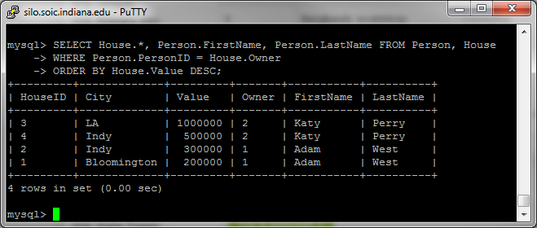
SQL – Joining Tables
Here, we rank the houses by Value and list their owner’s FirstName and LastName:

Slide 50
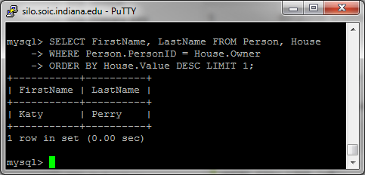
SQL – Joining Tables
A small change to that query gives us the name of the person who owns the most expensive house:

Slide 51
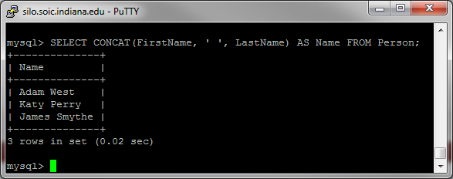
SQL – CONCAT and AS
The built-in function CONCAT allows us to combine fields. The AS operator allows us to use a custom field name:

Slide 52
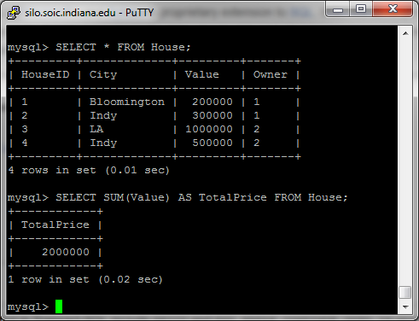
SQL - Summing
The built-in function SUM allows us to total up numeric fields in a query:

Slide 53
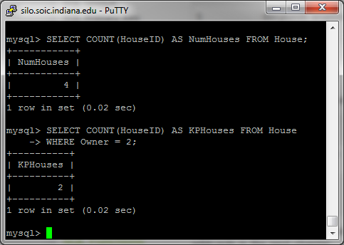
SQL – Counting
You can use the built-in function COUNT in SQL to tell you how many results there are:

Slide 54
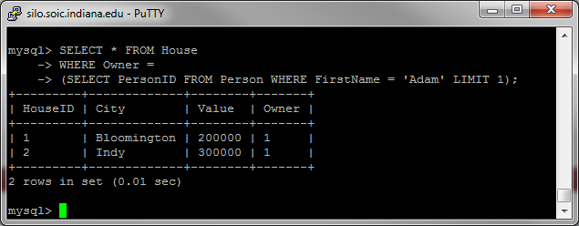
SQL – Nesting Queries
You can create nested queries by using results from one query to restrict another:

Slide 55
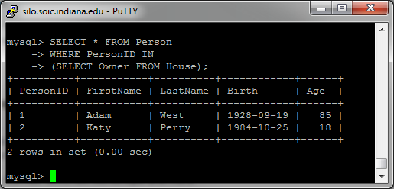
SQL – Nesting Queries with IN
The IN operator works in situations where a nested query returns more than 1 result:

Slide 56
LA Houses (Group Work)
Add a new entry to House – give one of the other people a house in LA.
Use a nested query to get the FirstName and LastName of anyone who owns a house in LA.

Slide 57
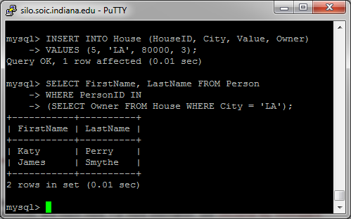
LA Houses (Solution)

Slide 58
Questions?

